Slide 1
INTERPOL’s Role and Effort in Combating Cybercrime
Sanjay Virmani
Director
INTERPOL Digital Crime Centre

Slide 2

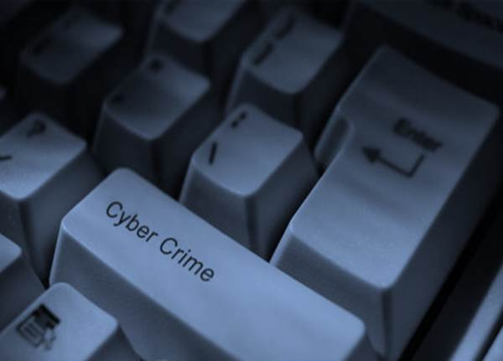
CHANGING FACE OF CRIME

Slide 3
Extortion
Pharmaceutical
Terrorism
Money Laundering
sales
Illegal gambling
Fraud
Identity Theft
illicit goods
Illegal Online Gambling
Trafficking in human beings
Financial
Organised Crimes
Malware
Cyber
Sextortion
Scam
Drug trafficking
Money laundering
Heist
DDoS
Ransomware
CHILD ABUSE SITES
Counterfeiting

Slide 4

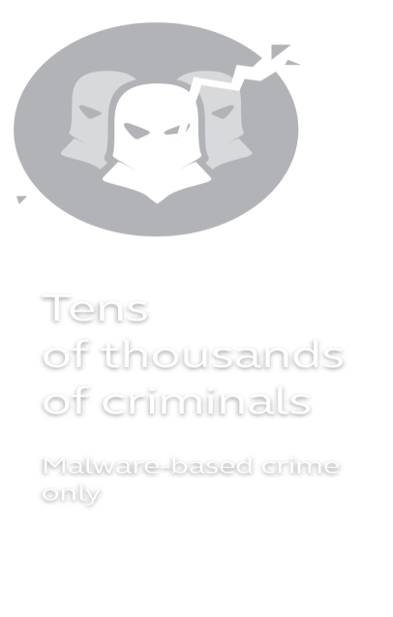
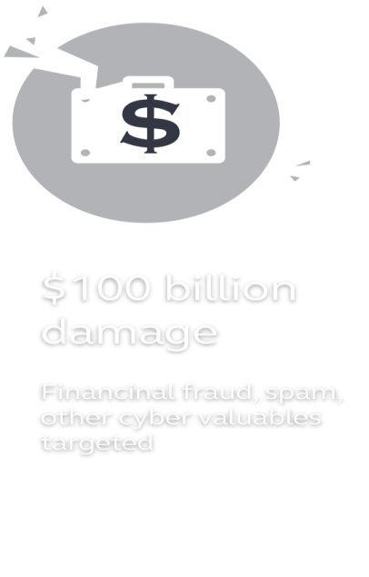

ESTIMATED RATES OF CRIME SERVICES
Crimeware
i.e. Zeus
DAMAGES
$500 - $10k
Consultation Services
i.e. Botnet Setup
DDoS
Services
$535 per week
Bulletproof hosting Services
$350 - $400
Email Spam Services
Web Spam Services
$3 per month
$40 per 20K emails
$2 per 30 posts
Fortinet 2013 Cybercrime Report

Slide 5

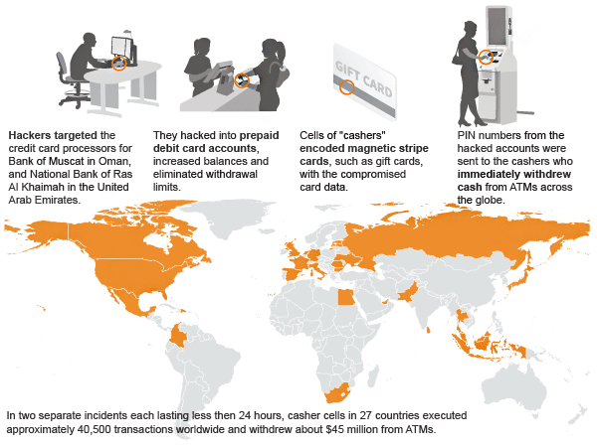
CASE: UNLIMITED OPERATIONS
In two separate incidents each lasting less then 24 hours, casher cells in 26 countries executed approximately 40,500 transactions worldwide
Withdrew USD5 millions in December 2012 and USD40 millions in Feb 2013.

Slide 6
Hackers
Cashers
Ringleaders
STRUCTURE OF “UNLIMITED OPERATIONS”
Surgical precision of the hackers
Global Breadth
Speed and coordination of the operations

Slide 7




CYBERCRIME IN NUMBERS
378 M Victims/Year
+1 M Victims/Day
12 Victims/Second
+ $400 BN
ANNUAL COST TO GLOBAL ECONOMY RESULTING FROM CYBERCRIME
Attacks per
Company in 2013
100+
USD $298
AVERAGE COST PER VICTIM
Average time
to resolve incident
32 days
Attack costs per
Company in 2013
USD11.6M
Economic impact of cybercrime II, Center for Strategic and International Studies June 2014
The 2013 Cost of Cyber Crime Study, Ponemon Institute, 2013
Norton Report 2013

Slide 8



CHALLENGING LANDSCAPE FOR POLICE
Transnational nature of organized cybercrime
Restrictions in information sharing
Time-lag in jurisprudence
Fast evolving technology and methodology used by criminals
Lack of resources – human, hardware, software, skills
Resources

Slide 9
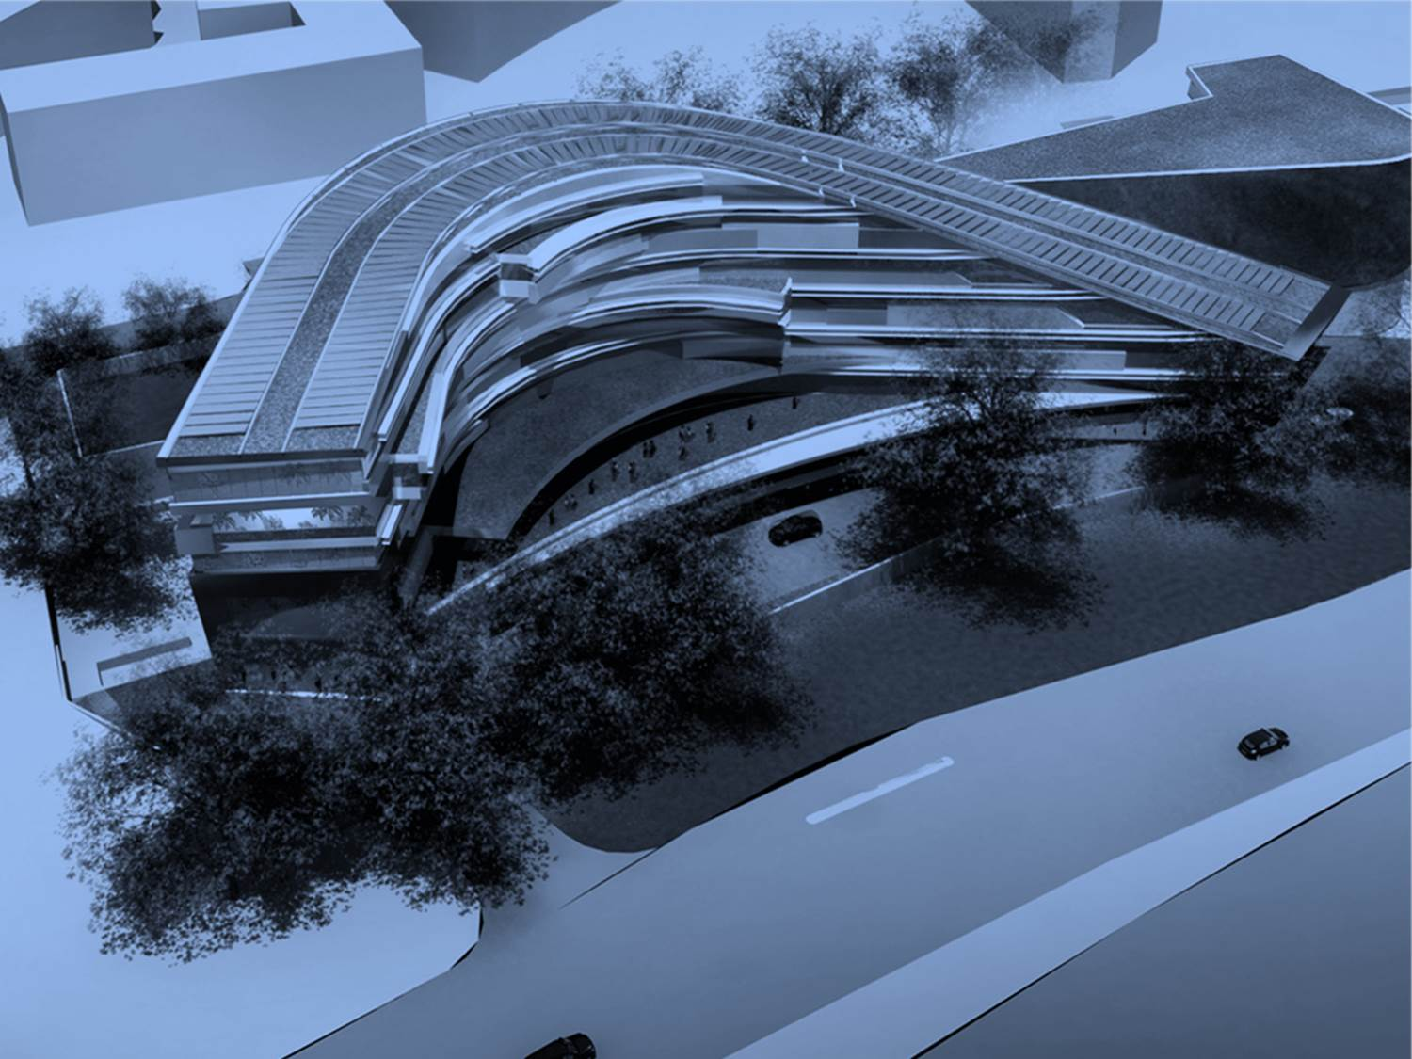
INTERPOL GLOBAL COMPLEX FOR INNOVATION

Slide 10

INTERPOL GLOBAL ALLIANCE AGAINST CYBERCRIME
OPERATIONAL SUPPORT
CAPACITY BUILDING
HARMONIZATION

Slide 11
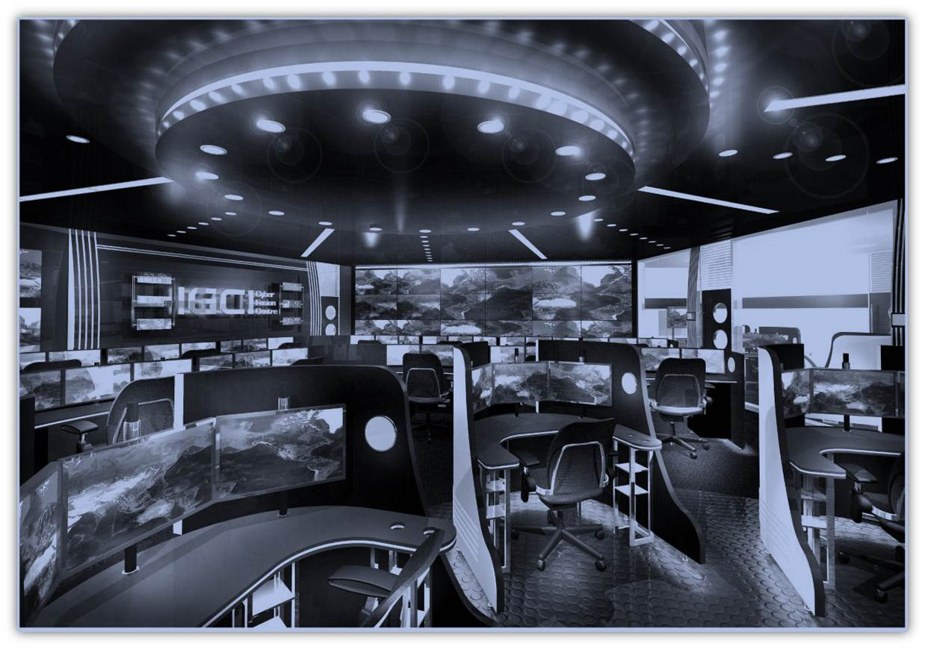
OPERATIONAL SUPPORT
Cyber Fusion Centre
Digital Forensic Laboratory
Platform for Police to Police Cooperation and Information Sharing

Slide 12
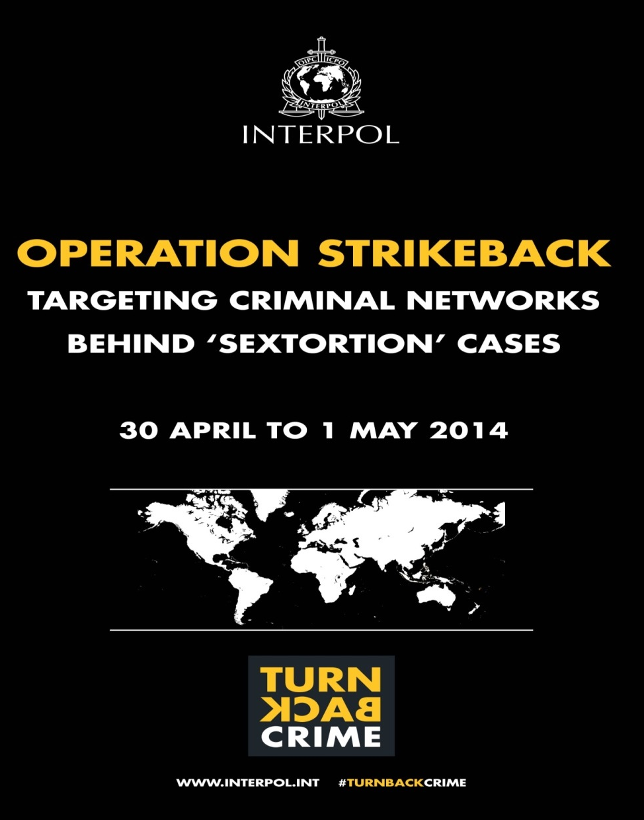
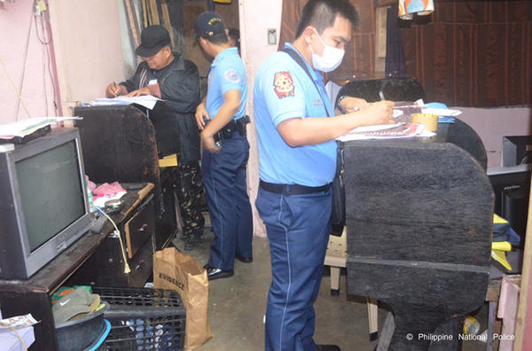
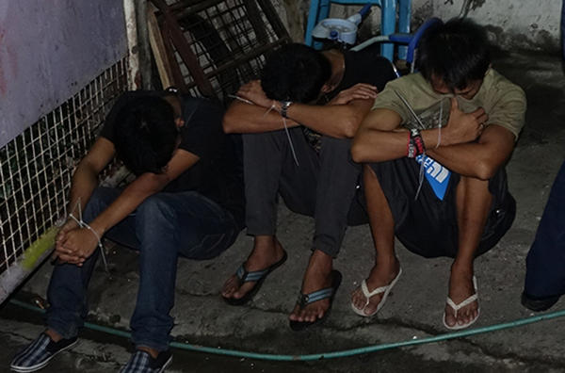
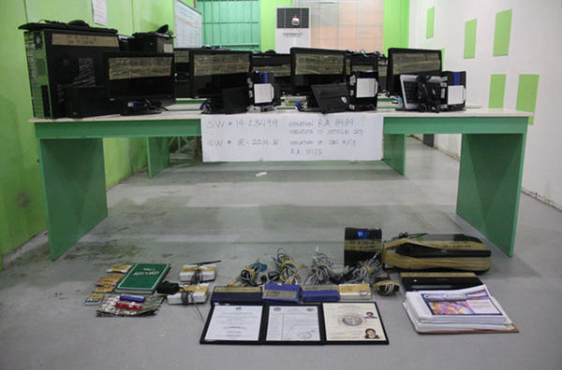
5
COUNTRIES PLAYED A ROLE IN THE ACTION
58
SUSPECTS ARRESTED
250
PIECES OF ELECTRONIC EVIDENCE SEIZED

Slide 13
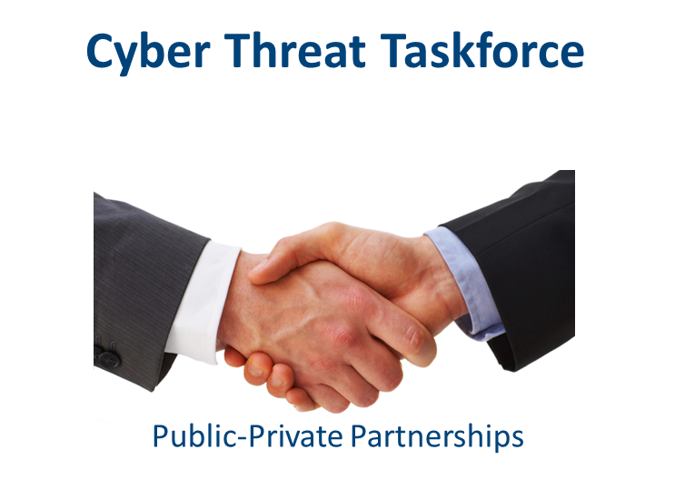
PUBLIC–PRIVATE PARTNERSHIPS
Introduction of Resource Assignment Agreements
Development of Public-Private Partnerships (PPPs)
INTERPOL’s Strategic Partnership with private sector

Slide 14

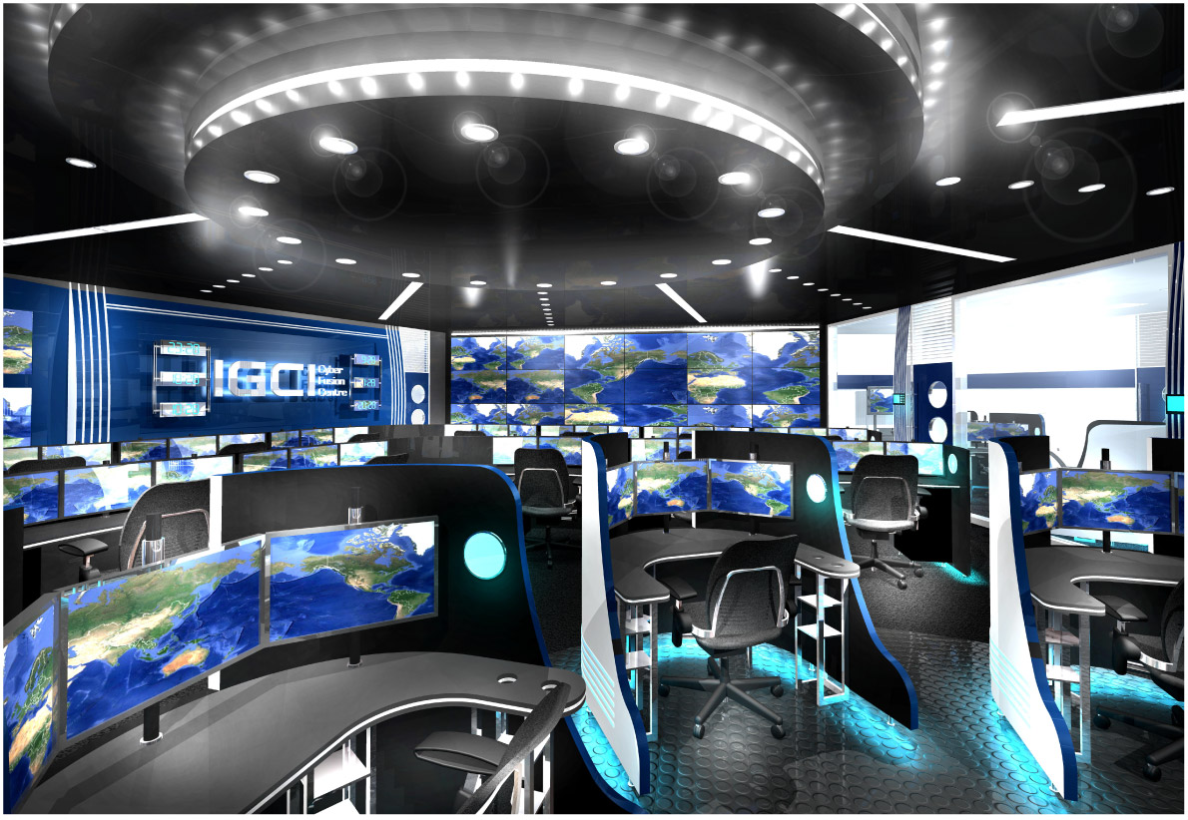
FROM DATA TO ACTIONABLE INTEL
PRIVATE SECTOR
ACADEMIA
MEMBER COUNTRIES
CYBER FUSION CENTRE
INTELLIGENCE
TREND ANALYSIS
INTELLIGENCE
ACTION
EVIDENCE COLLECTION
COORDINATION
INVESTIGATION SUPPORT
REPORT/ALERT
MONITORING
CRIME CASE ANALYSIS
RESULTS
ALERT/NOTICE
INVESTIGATION
ACTIONABLE INTEL

Slide 15

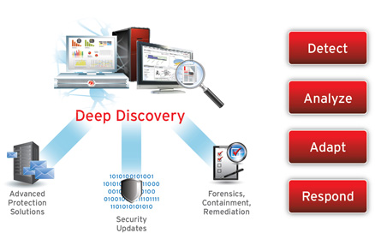





COOPERATION WITH
TREND MICRO
Monitor
Intel Repor
Detect
Analyse
Compile
Forward
Action
Member Countries

Slide 16

HARMONIZATION
Advocacy on Internet Governance
National Cyber Reviews

Slide 17

CAPACITY BUILDING
Cybercrime Training
Leveraging Expertise and Deconfliction

Slide 18


Regional COOPERATION
EC³
IPSG LYON
RB SAN SALVADOR
RB ABIDJAN
RB NAIROBI
IGCI SINGAPORE
RB BUENOS AIRES
RB YAOUNDE
RB HARARE
Regional Working Groups
African
Americas
Eurasian
MENA

Slide 19

THREAT RESEARCH AND FUTURE TRENDS

Slide 20
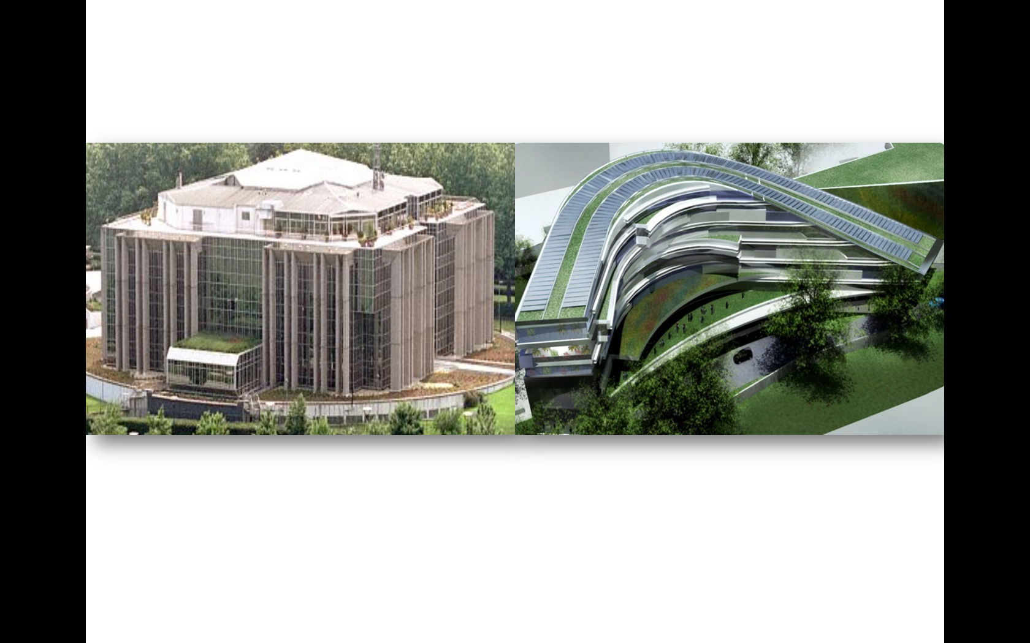
نشكركم جزيل الشكر على انتباهكم
Thank You-Merci-Gracias
Mr. Sanjay Virmani
s.virmani@interpol.int

